Slide 1
E.L.S.A. Electro Luminescent Safety Apparatus
Presented in a function / task / decision tree analysis
Notes:
ELSA is a joint University of Connecticut Engineering Senior Design project with MEM and ECE teams. In the Spring semester, this project was called ‘Making Rural Roads Safer’ but was renamed ‘ELSA’ since the first iteration presents an ICY caution message as a hazardous condition as a reference to the character Elsa in the Disney classic ‘Frozen’.
Two students from each department are participating in designing an end-to-end traffic sign system using electroluminescent panels to warn drivers of hazardous conditions in real time. ELSA monitors environmental conditions, notifies on-coming vehicles of a current condition (icy roadway, children present), collects event data such as temperature, humidity, vehicle count and transmits this data to an ArcGIS server on the Storrs campus. The data is used to assess local weather conditions and traffic patterns to allow Department of Transportation to adjust resources.

Slide 2
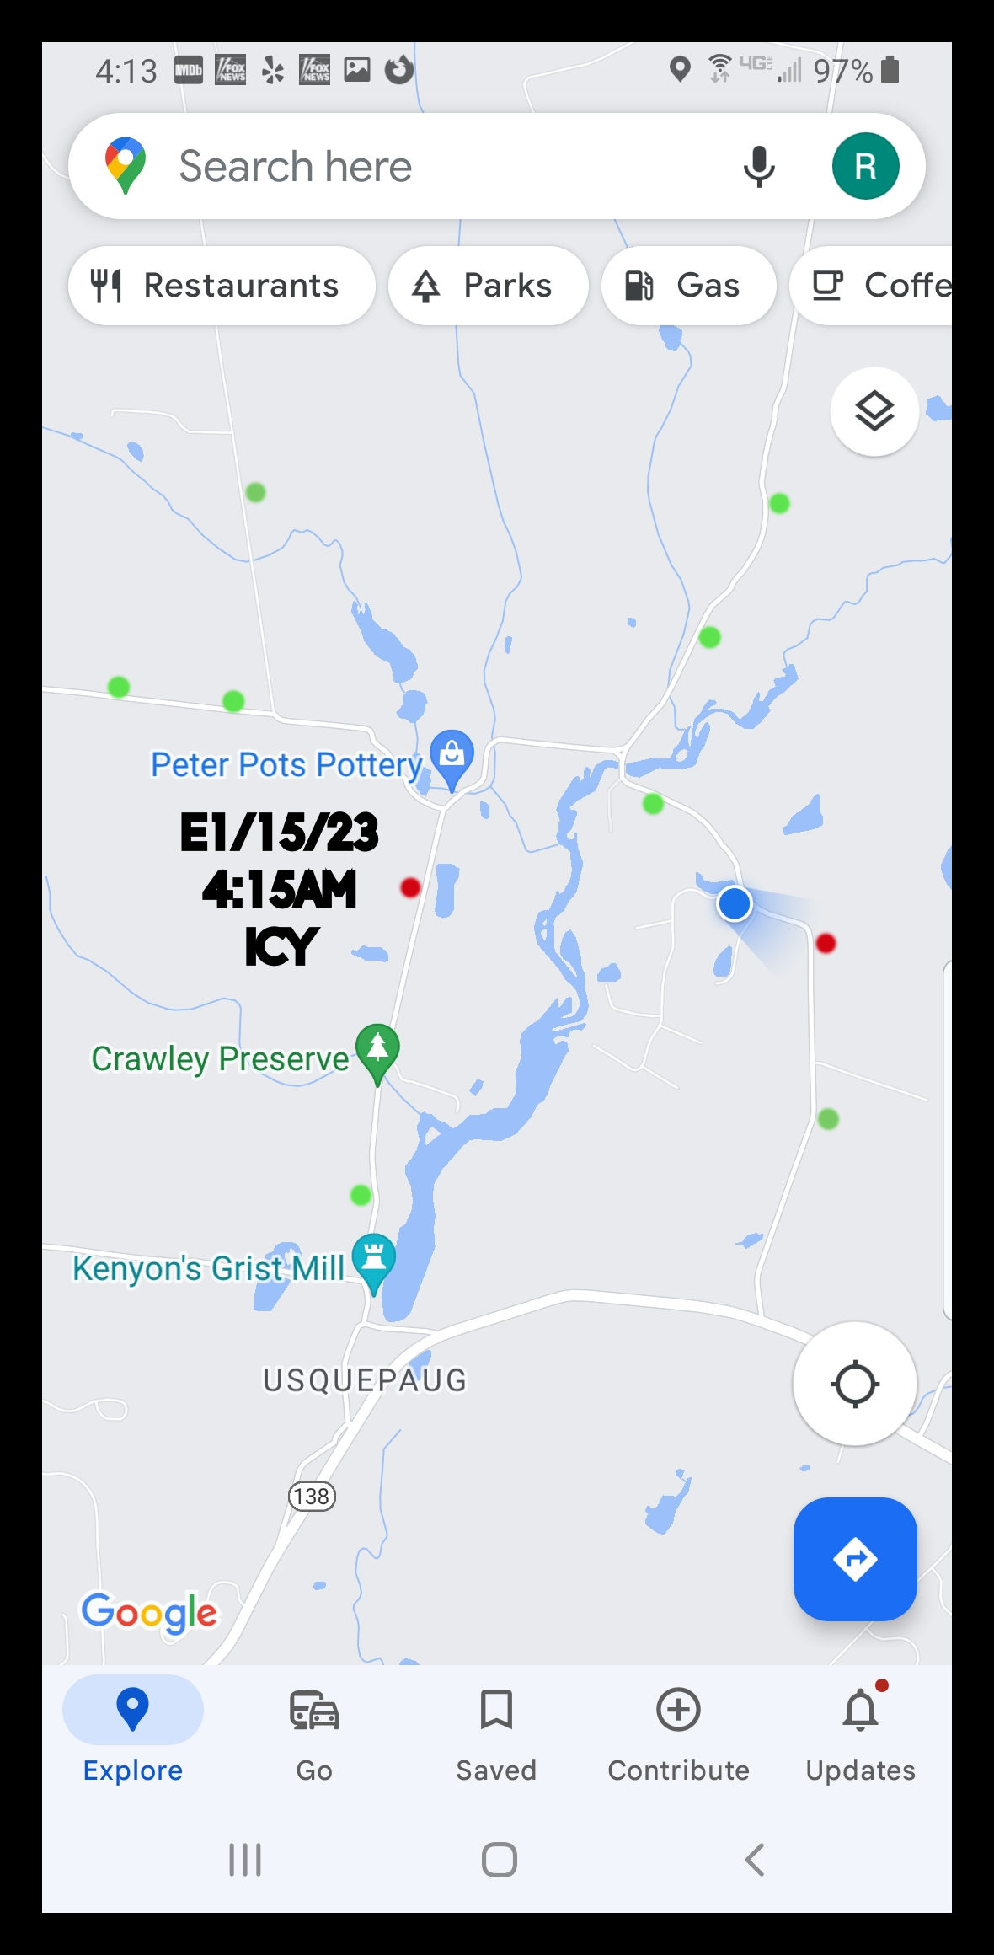
What is E.L.S.A?
ELSA is an interconnected system of sign stations, ArcGIS server resources and a smart phone user interface designed to reduce speeding on Connecticut rural roads – the primary cause of off roadway departures, accidents, and death.
The system consists of:
Configurable hazard identification and action message electroluminescent panels
Temperature and humidity sensors
Microprocessor
Python and C+ software
Solar and battery power supplies
Internet connectivity to ArcGIS server
Smart phone and computer interface
SIGN STATIONS
ArcGIS server
USER INTERFACE
+
+
A University of Connecticut Engineering Senior Design Project MEM 4971 Team 12 Richard Davids, Sponsor.
Notes:
The ELSA system is composed of traffic sign stations located along rural roadways just like other DOT systems that indicated an intersection, ‘stop’, or horizontal alignment. Each station is self contained with electroluminescent panels, sensors, microprocessor, power supplies and Wi-Fi connectivity.
Each station is designed to be a stand-alone piece of equipment and not connected to external power source. A solar panel charges a 12-volt battery that powers the electronics and electroluminescent panels. Each station connects to a local wireless access point. An ArcGIS server integrates the event data and enables displaying event data on a smart phone and computer.

Slide 3
How Do We Analyze and Allocate Functions, Tasks and Events to E.L.S.A?
By performing system engineering analyses to define specific tasks, information and steps needed to ensure ELSA works properly.
Function analysis
Task analysis
Concept of Operations
Decision analysis
For ELSA, these system analyses are combined into a decision tree format.
A University of Connecticut Engineering Senior Design Project MEM 4971 Team 12 Richard Davids, Sponsor.
Notes:
Systems engineering analyses are performed to allocate (assign) responsibilities to parts of the system. Top level functions are broken down into tasks and events or actions. For ELSA, the sponsor performed these systems analyses and depicts them in a final decision tree format.
These analyses can be considered a simplified pictorial Concept of Operations (CONOPS). CONOPS for large systems are presented in narrative format with many illustrations and figures. For this project, a decision tree analysis helps to understand waypoints (decisions) that must be made to operate the system. Waypoints are presented as yes/no decision points along the operational pathway.

Slide 4
What are Function / Task / Concept of Operations Analyses?
A Function Analysis Illustrates a series of events that must happen to accomplish an objective.
Series and parallel functions are identified in individual blocks.
A Task Analysis is a method for producing an ordered list of all the tasks needed to perform a function.
A Concept of Operations integrates the scenarios into a composite system behavioral timeline with internal and external system inputs/outputs.
A University of Connecticut Engineering Senior Design Project MEM 4971 Team 12 Richard Davids, Sponsor.
Notes:
To better understand how ELSA works, a systems engineering analysis was conducted. This analysis combines classic systems engineering tools such as function, task, and decision tree analysis to decompose the system. Functions are top level things that the system must do like ‘perform station health check’ or ‘power electronics. A task is a second level thing like ‘check battery power’ or ‘check sensors. Certain decisions must be made while the system is operating like temperature at or below 32 degrees F. Functions, tasks and decisions are combined in this decision tree analysis.

Slide 5
Function/Task/Decision Tree Analysis
ELSA station
Station Startup and Monitor Environment
Power up electronics
Processor
Clock
Location
Temperature sensor
Humidity sensor
Power
Perform Health Check
Health Check, OK?
Detect sound?
Monitor environment
Go to next page
YES
YES
Send health file to ArcGIS server
NO
NO
A University of Connecticut Engineering Senior Design Project MEM 4971 Team 12 Richard Davids, Sponsor.
Notes:
This operational analysis begins at an ELSA sign station. Sign station power must be turned on to operate the system. This action will start the process of converting battery DC power to AC power to energize the ELSA sign station. ELSA should periodically perform a system health check, perhaps every 24 hours or when a power interrupt occurs. The health check would include power output, sensor readiness, GPS location, clock time and processor.
If the health check satisfies preprogrammed parameters plus tolerance (+ / - ), then a health status report is sent to the ArcGIS server. Likewise, if any parameter is out of spec, then a health status report is transmitted. If the health check meets tolerance requirements, then the sign station monitors the environment. Monitoring the environment means ‘listening’ for a local sound such as an approaching vehicle, monitoring and recording temperature and humidity. We are not worried about ‘false positives’ which might be a low flying aircraft or target shooting blasts.
If a sound is detected, then the clock starts recording the event. Event data includes duration of the sound measured in seconds. From the sponsors experience, events will occur every 3 – 5 minutes during daytime and every 45 minutes at night. Events last between 6 and 20 seconds, typically.

Slide 6
Function/Task/Decision Tree Analysis
Clock time
Location
Temperature
Humidity
Power
Total event time
Location
Temperature
Humidity
Power
Send event file to ArcGIS server
Go to next page
Start event recorder
Build event file
Turn ‘SLOW’ panel ON
Panel Activation
Turn ‘DOWN’ panel ON
Turn ‘ICY’ panel ON
Temp 32 deg ?
Humidity 70 % ?
YES
YES
NO
NO
A University of Connecticut Engineering Senior Design Project MEM 4971 Team 12 Richard Davids, Sponsor.
Notes:
At the same time a sound event is detected, ELSA will activate the ‘SLOW’ and ‘DOWN’ panels. Panels should stay illuminated (activated) until the end of the sound event or at least 15 seconds to time out and reset the panels.
Two conditions need to happen almost simultaneously for the ‘ICY’ panel to activate. According to most meteorological data, snow and or ice starts to form when the temperature is about 32 degrees F and the humidity is about 70%.
If the two sensors detect this condition, then a signal is sent to the ‘ICY’ panel inverter to flip and activate. This signal will trigger an event file to be built that collects the start and end times, the elapsed time, temperature and humidity plus ELSA station location. This file is then sent to the ArcGIS server.

Slide 7
Function/Task/Decision Tree Analysis
Smart Phone User Interface Alert
ArcGIS receive event file
Elapsed event time
Location
Temperature
Humidity
Power
Display alert on smart phone UI
Color coded alert with text message
User clicks on alert
User acknowledges alert
Arc GIS records total event
Monitor system
Monitor Environment
Display alert and event data
A University of Connecticut Engineering Senior Design Project MEM 4971 Team 12 Richard Davids, Sponsor.
Notes:
After an event, a message is sent to the ArcGIS server. After authenticating the message, ArcGIS forces an alert popup on the smart phone or computer user interface. Any user logged into the system can activate the alert and acknowledge receipt. A color-coded popup might identify a condition, time and date as well as location of station activation.
Given the restrictions of time and personnel, only a prototype of the user interface is expected as part of this senior design project. It would be extremely advantageous if a real working prototype with end-to-end connectivity is developed. Such an achievement would demonstrate the possibilities to the Connecticut Department of Transportation and applying the demonstration as evidence for a $500K CTDOT grant.

